Slide 1
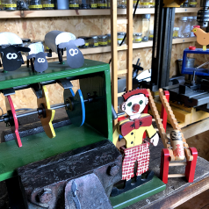
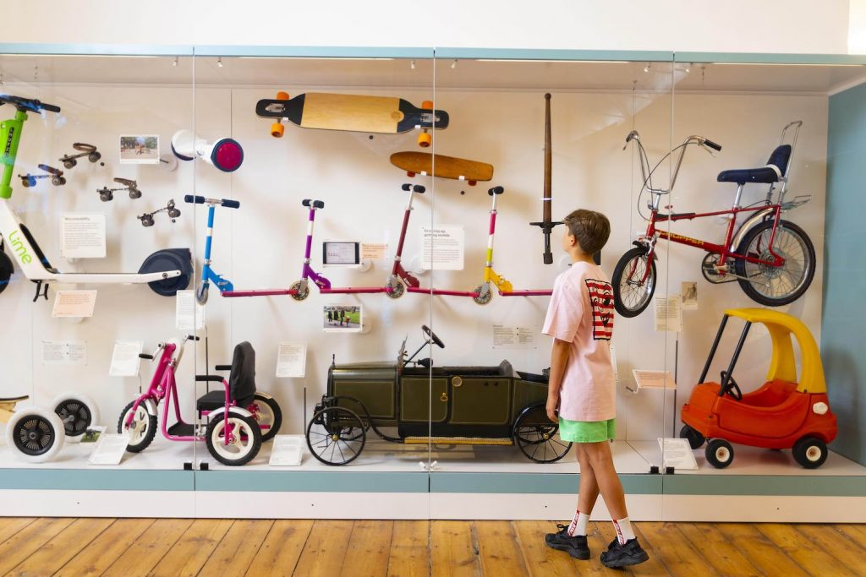
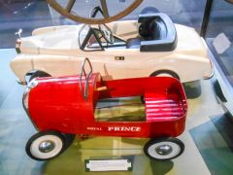
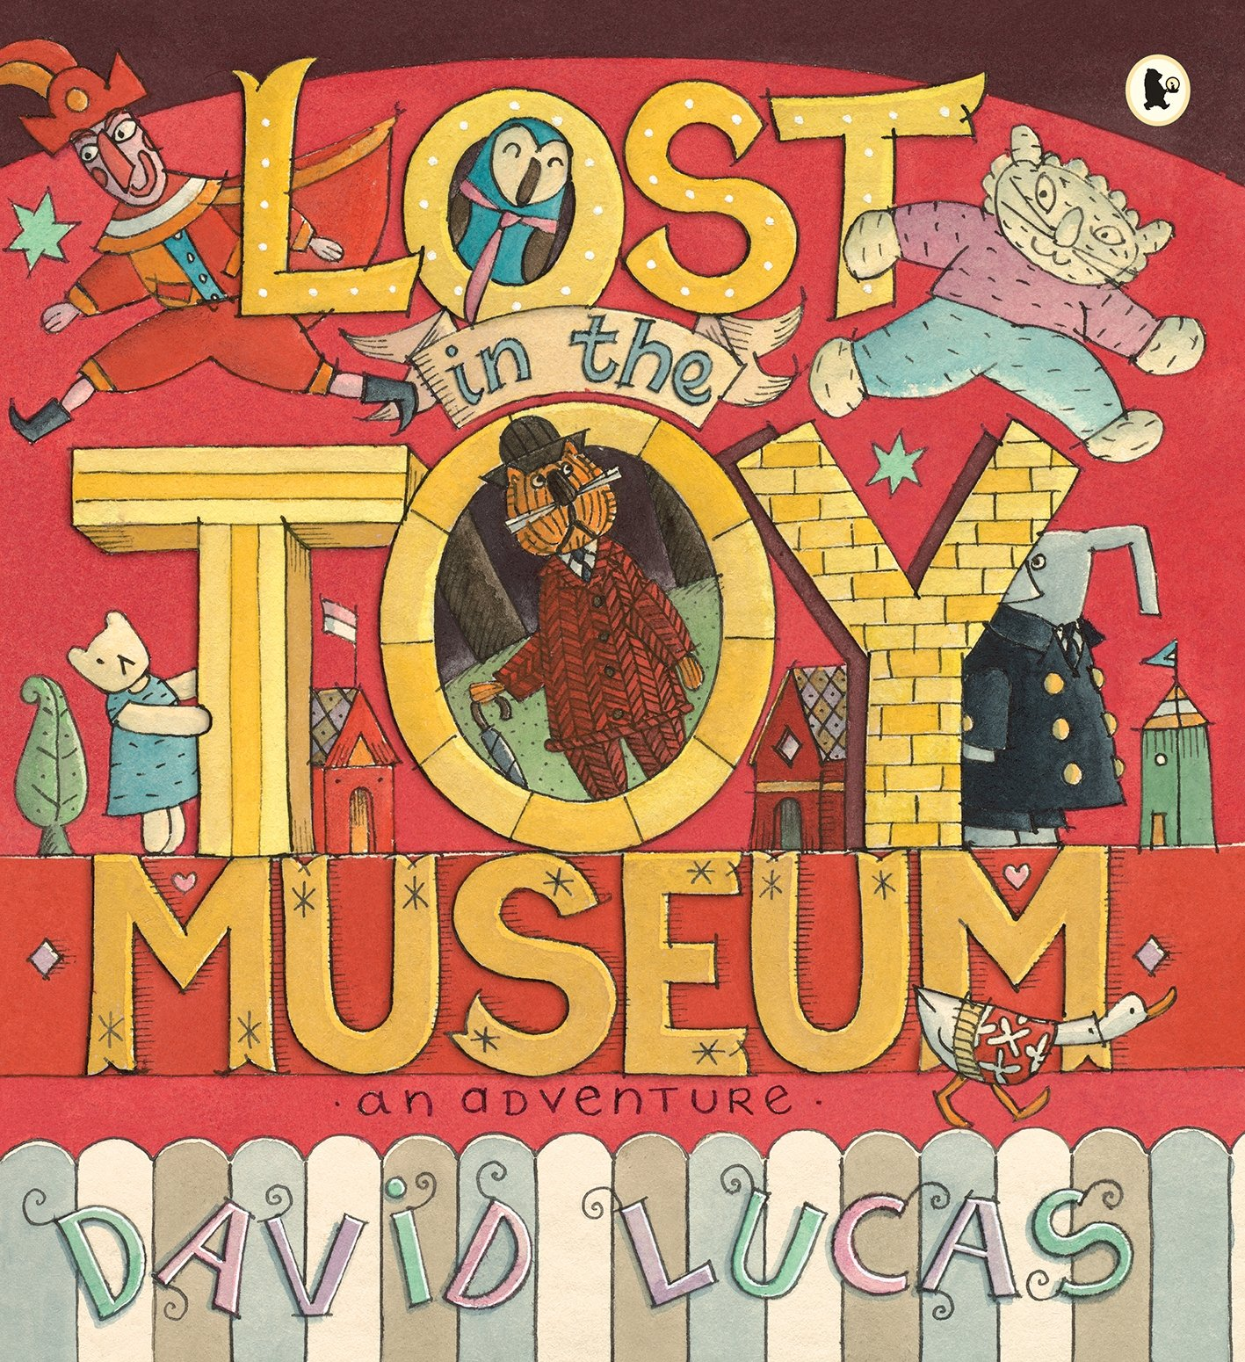
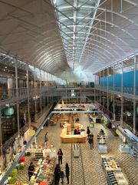
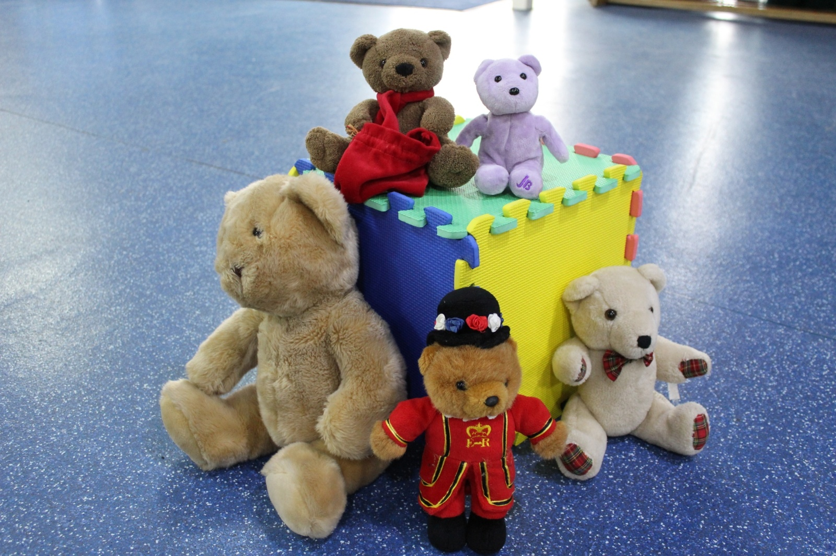
Summer Term
A message about Year 2
Welcome back! We hope you all had a lovely Easter break and are ready for the exciting things we have planned for the next few weeks!
In English, we will be reading the book ‘Lost in the Toy Museum’ by David Lucas. We will be creating our own toy museum within our classrooms, writing labels for each toy, creating posters and invitations to invite people to come along. This book links closely to our topic ‘The Magic Toymaker’.
In Maths, we will be we will be exploring fractions. We will be exploring ½, ¼, 2/4, ¾ and 1/3. We will be learning how to find these fractions of both a shape and a number. We will also be focussing on how to tell the time to the hour, half past, quarter past and quarter to. We will then be moving onto telling the time to five minute intervals.
In History, we will be looking at a range of toys from the past. We will be generating questions to ask family members about their favourite toys when they were young. We will also be looking at a range of different materials and deciding which material is best suited to which toy and why. We will finish our new topic with creating our own board games for others to play!
Homework
Homework books will be sent out every Wednesday. Please complete one activity from the sheet per week.
Please ensure homework book come back in every Monday for the teachers to see.
Reading – please ensure you are reading with your child every day and recording this in their reading record. Children will receive Dojo points if they read 3 times in a week.
Spellings – these will be sent out each half term in the back of your child’s homework book. Spelling tests will happen each Friday.
PE Weekly time table
Elton John class - Tuesday & Wednesday
Muhammad class - Wednesday & Thursday
Tull class - Monday & Wednesday
Reminder for children to be in by 8:45am
and collected at 3:15pm
We are hoping to go to the V&A museum of childhood where we will explore toys from the past to the present.
Uniform
Dark grey school trousers or skirt or navy blue pinafore dress or skirt.
White polo shirt.
Navy jumper or cardigan.
Plain dark or white socks or tights.
Plain black school shoes or trainers.
PE kit: white t-shirt
Navy shorts or tracksuit bottoms
Navy blue sweatshirt
Black plimsolls or plain black or white trainers

