Slide 1



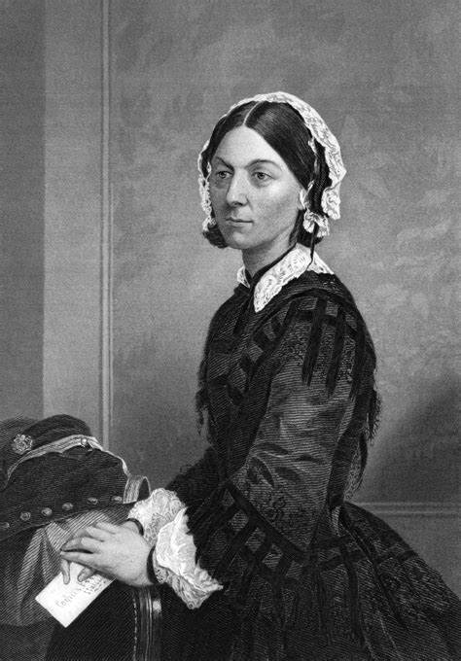

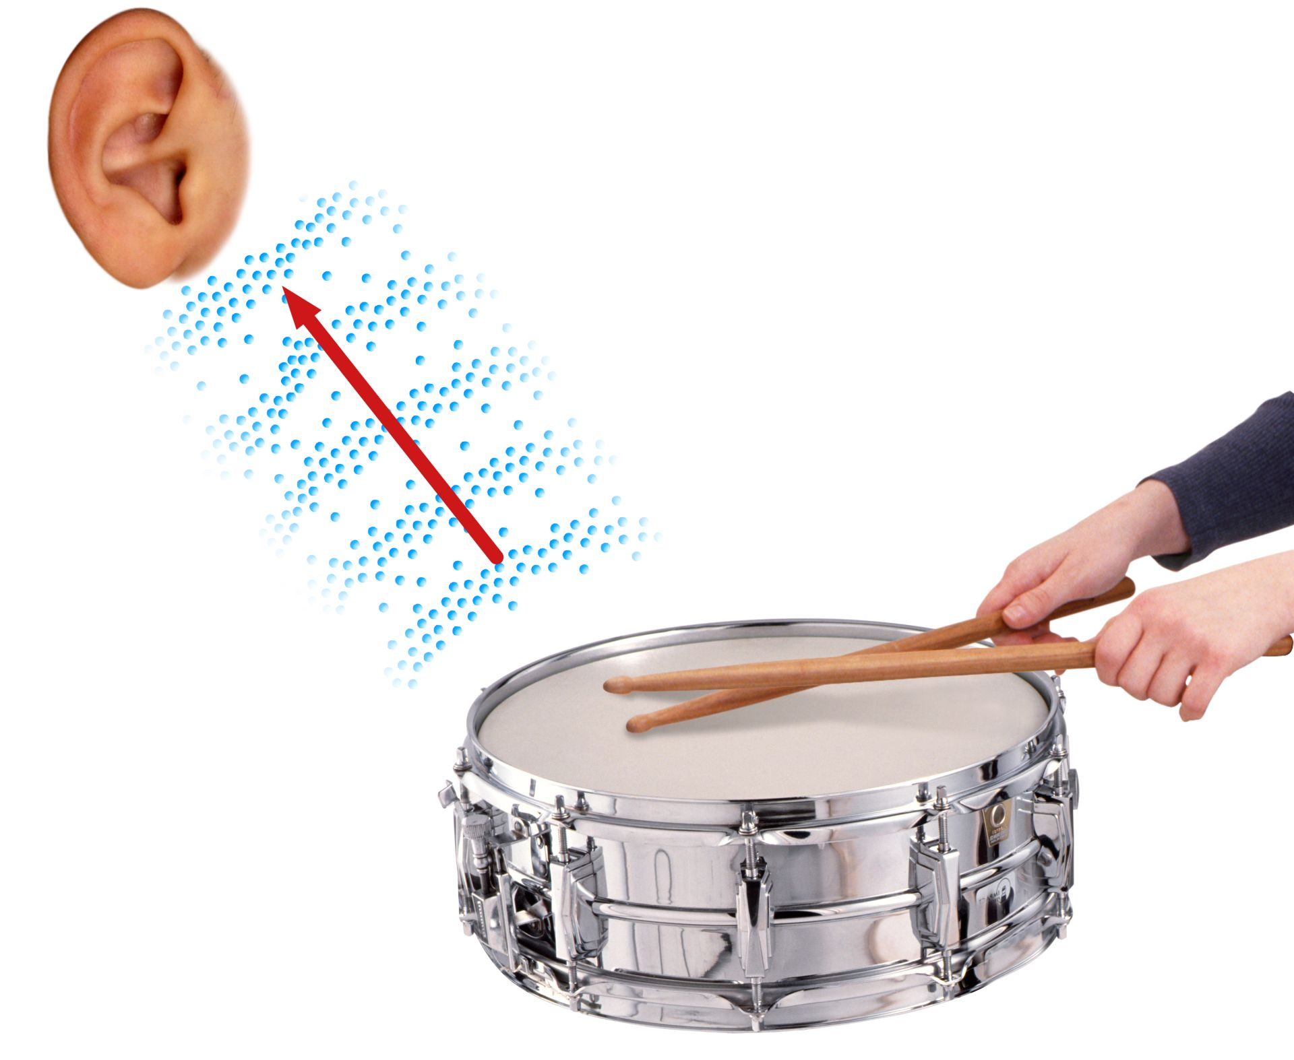
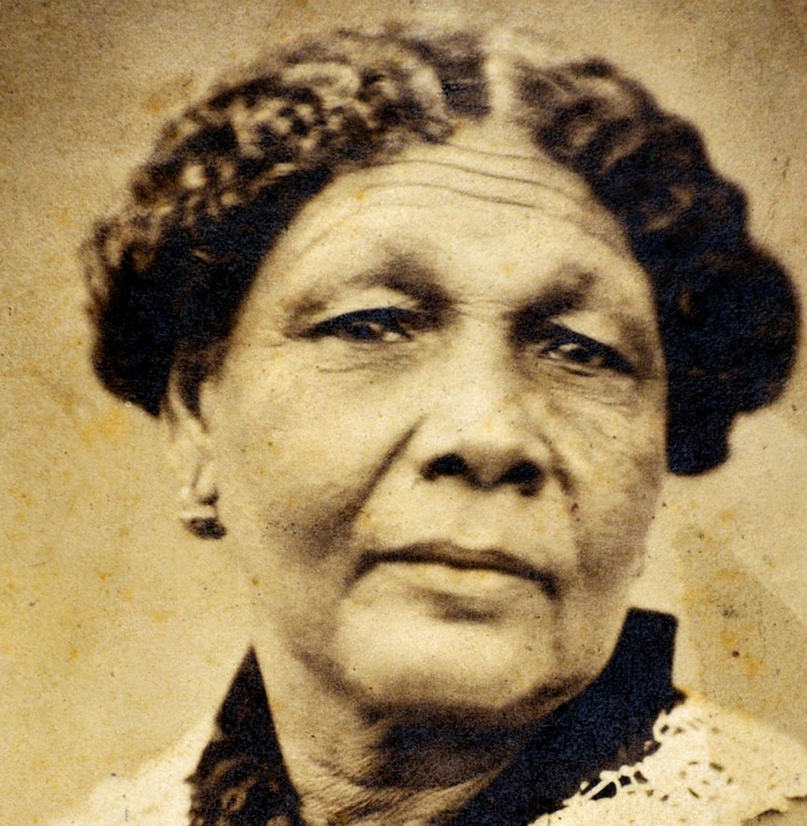
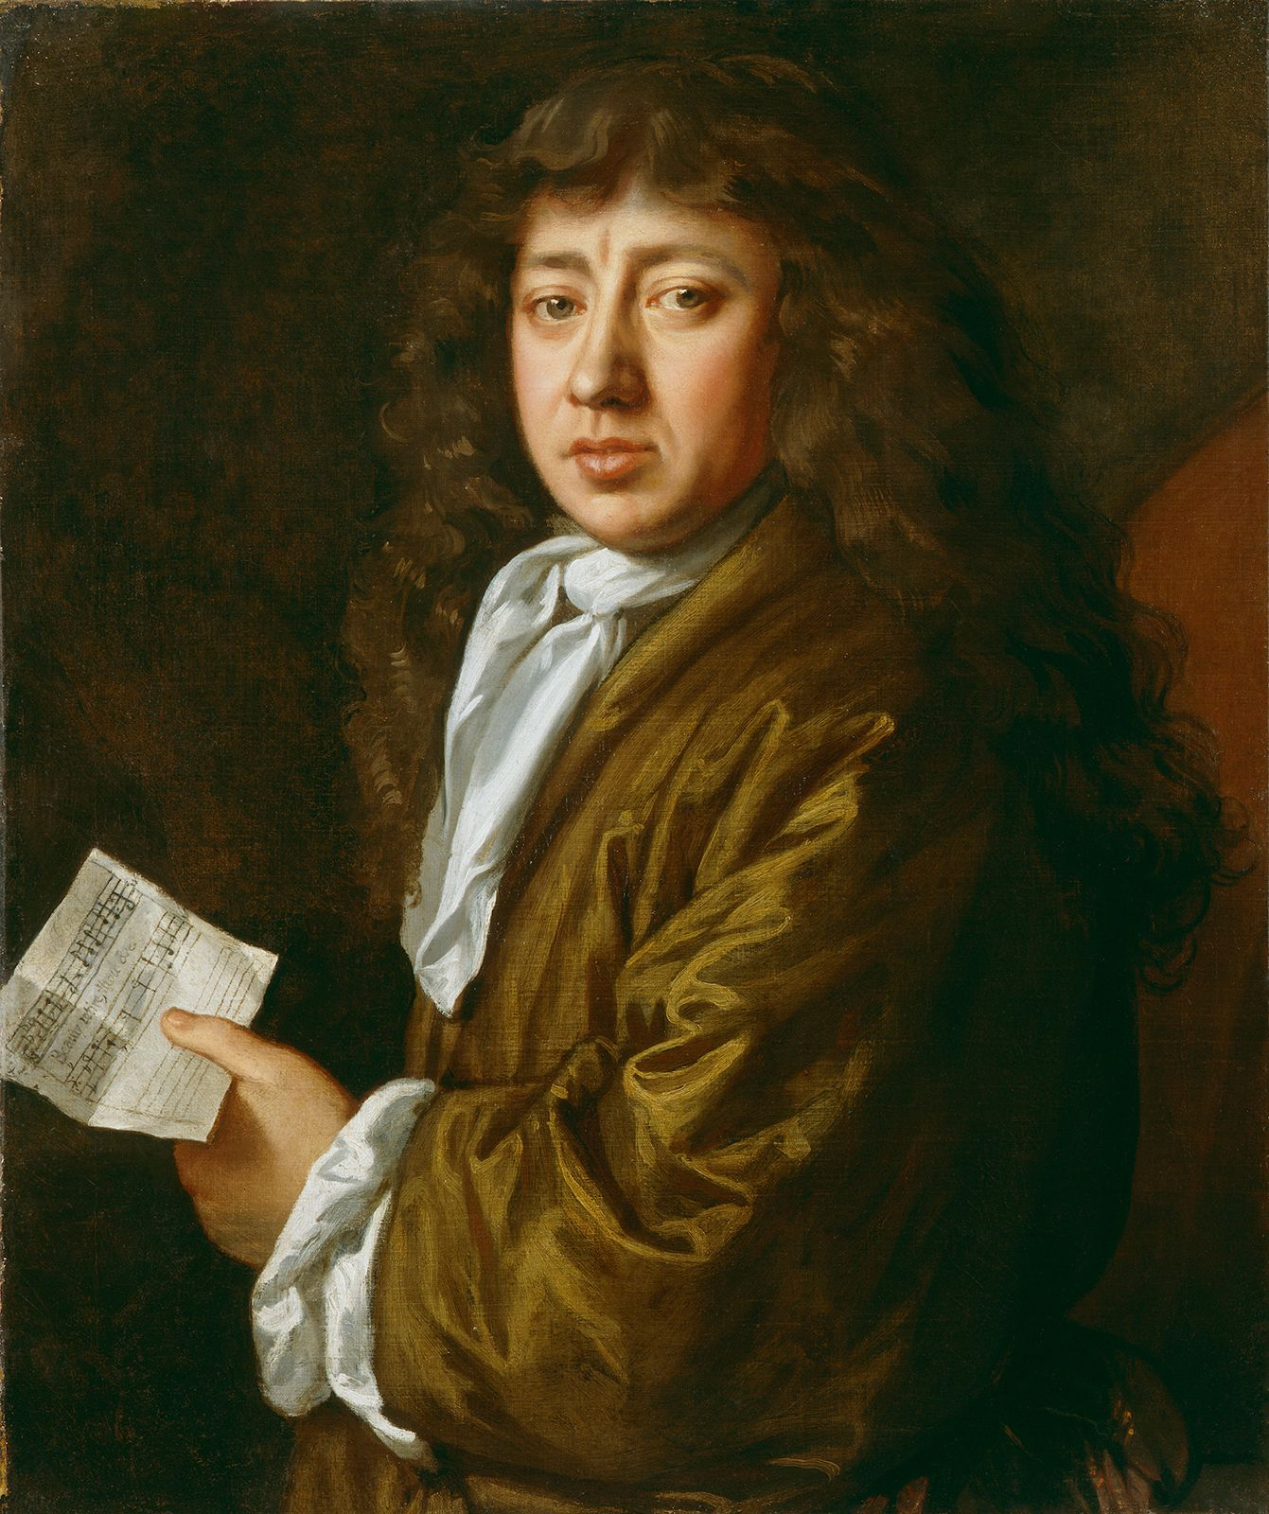
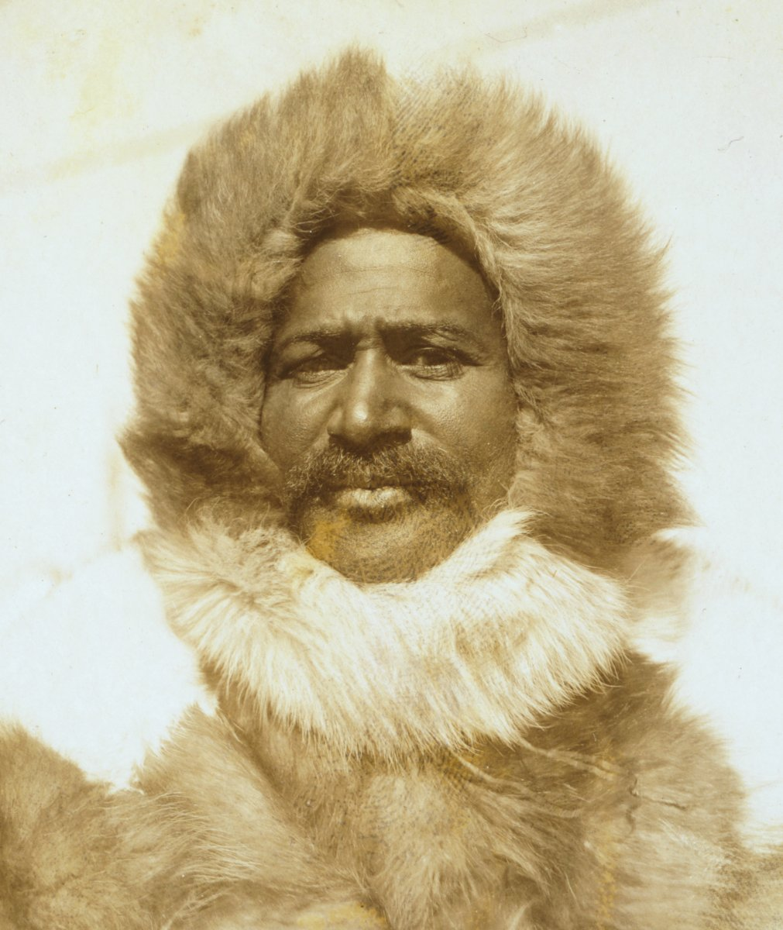
Summer Term
A message about Year 2
Welcome back! We hope you all had a lovely May half term and are ready for the final few weeks before the end of the year!
In English, we will be reading the book ‘Fantastic Mr Fox’ by Roald Dahl. We will be writing character descriptions for different characters within the story with a focus on adjectives, expanded noun-phrases and similes to ensure our writing engages the reader. We will be writing poetry and performing these to the class using expression. We will also be writing in character as ‘Mr Fox’ and imagining what it would be like if we were him!
In Maths, we will be looking at telling the time to O’clock, half past, quarter to and quarter past. We will be challenging ourselves with telling the time to 5-minute intervals. We will also be exploring different ways to present data including tally charts, pictograms and block diagrams. Lastly we will be exploring position and direction where we will be looking at positional language.
In History, we will be looking at the lives of Mary Seacole, Florence Nightingale, Matthew Henson and Samuel Pepys and learning why they are important people from the past.
In Science, we will be learning what is a source of light is and also how sounds are made.
Homework
Homework books will be sent out every Wednesday. Please complete one activity from the sheet per week.
Please ensure homework book come back in every Monday for the teachers to see.
Reading – please ensure you are reading with your child every day and recording this in their reading record. Children will receive Dojo points if they read 3 times in a week.
Spellings – these will be sent out each half term in the back of your child’s homework book. Spelling tests will happen each Friday.
PE Weekly time table
Elton John class - Tuesday & Wednesday
Muhammad class – Monday & Wednesday
Tull class - Monday & Wednesday
Reminder for children to be in by 8:45am
and collected at 3:15pm
Uniform
Dark grey school trousers or skirt or navy blue pinafore dress or skirt.
White polo shirt.
Navy jumper or cardigan.
Plain dark or white socks or tights.
Plain black school shoes or trainers.
PE kit: white t-shirt
Navy shorts or tracksuit bottoms
Navy blue sweatshirt
Black plimsolls or plain black or white trainers

